Slide 1

SASA- Chitti Version 3.0
SASA
Chitti Version 3.0

Slide 2
Introduction
Most of what we know about the elemental composition of Mars comes from orbiting spacecraft and landers.
If you google something about this, all you can find is “there ‘may’ be iron, magnesium, calcium, etc”. There is no proper confirmation as to which element is present where and in what quantity.
In order to make a proper plan for living on Mars, we need to know all these details.
Notes:
What’s the use of the rover? Well, for example, during planetary exploration, ripples on sand dunes on Mars were found by Curiosity rover. This helped figure out that atmosphere had thinned over the years. Beyond a certain limit of thinning, life would be impossible on Mars. That’s a problem which was found out through a rover intending to do similar functions as us.

Slide 3
Project Features
Rover Features
Solar Powered
Autonomous (using Image Processing)
Bore to dig into the soil
Automatic wind protection
Find the weather, temperature and pressure of the planet
Find the soil moisture which will help us realize if water is available in the soil in that area
Feature detection for planetary exploration

Slide 4
How Are We Different?
The major difference between other rovers and Chitti is that Chitti won’t get filled by dust and other sources of contamination even during sandstorms because of the features we have tried to incorporate into it.

Slide 5
Future Plans
Being freshers we couldn’t make a project which would match ISRO or NASA standards but our aim is to not only reach their level, but to exceed their aims in the near future!
A few problems which may be encountered in space which have been missed will be included in the future.
We intend to add more features which will help mankind know whether a planet is habitable or not.

Slide 6
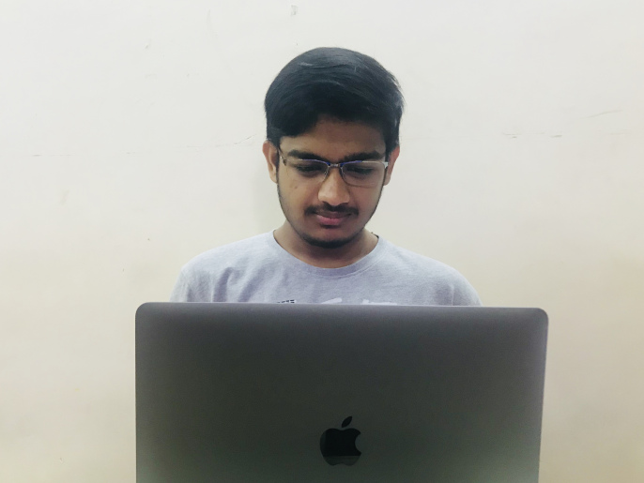
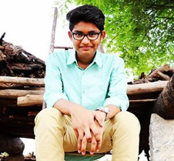


OUR
TEAM
Akshat Gupta
Sai Sandeep
Aman Agarwal
Shivansh Srivastava
Notes:
POC: amvaraprasad@gmail.com

